Slide 1
AVVA VISTA VOLUNTEER
Introducing AVVA VISTA Volunteer Program
Help
Notes:
Give a brief overview of the presentation. Describe the major focus of the presentation and why it is important.
Introduce each of the major topics.
To provide a road map for the audience, you can repeat this Overview slide throughout the presentation, highlighting the particular topic you will discuss next.

Slide 2
AVVA VISTA =
“Volunteers in Service
To America”
Notes:
This is another option for an overview using transitions to advance through several slides.

Slide 3
Are you a Volunteer?
Set up for Chapter events?
Drive those who need rides to doctor visits?
Cook meals for your Chapter meetings?
Donate baked goods?
Make handcrafted items for sale or gifts?
Help the needy and homeless in your community?
Do You:

Slide 4
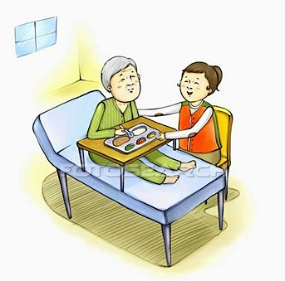
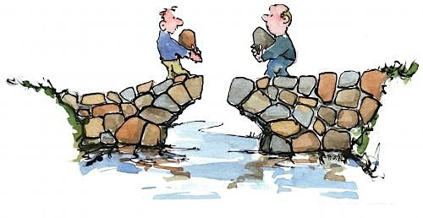
Or, Do You…..
Perform ceremonies for funerals or parades?
Spend time with those in need?
Assist in building or re-building “quality of life” items for those in need?
Volunteer at Chapter and State fundraisers?
Visit long term care facilities or hospitals?

Slide 5
Then Congratulations!
If you are doing these things in your capacity as an AVVA member, and you are doing these things for people who are not your relatives, then:
You are an AVVA VISTA Volunteer!

Slide 6
Time to make your efforts known:
AVVA is now tracking volunteer hours
Your time spent volunteering for AVVA is important!
3
2
1
Record volunteer hours
Notes:
This is another option for an overview slide.

Slide 7
WHY?
As a non-profit organization it is important that we give back to our communities and support Veterans of all eras.
The time is right for our membership to be recognized and rewarded for their service to Veterans and their communities.
If each of our over 10,400 members volunteer 10 hours a month, AVVA would be donating over 1,000,000 hours per year to our Veterans and to our communities.
Notes:
What will the audience be able to do after this training is complete? Briefly describe each objective and how the audience will benefit from this presentation.

Slide 8
Reporting your hours:
Notes:
Use a section header for each of the topics, so there is a clear transition to the audience.

Slide 9
Form all done?
Then – simply slip it in the mail or email it!
Notes:
Add slides to each topic section as necessary, including slides with tables, graphs, and images.
See next section for sample table, graph, image, and video layouts.

Slide 10
Recording the hours you report:
All VISTA volunteer hours will be recorded, and a report will be sent quarterly to all registered Regional Directors and State and Chapter Reps or Presidents.
This gives an overview of the individual, as well as a total of hours for each State and Chapter participating.
Notes:
Keep it brief. Make your text as brief as possible to maintain a larger font size.

Slide 11
Okay – Now What?

Slide 12
Rewards:
The top volunteers from across the Nation, in several categories, are recognized at National Conventions and Leadership Conferences.
Be a proud Volunteer. Keep track of your hours and report them. The effect you have on your community can be immeasurable!
Notes:
If there is relevant video content, such as a case study video, demo of a product, or other training materials, include it in the presentation as well.

Slide 13
Questions?
Notes:
Add a case study or class simulation to encourage discussion and apply lessons.

