Slide 1


AVVA WEBSITE
MAKING THE BEST USE OF A RESOURCE

Slide 2


Training Goals:
Become familiar with the different facets of the website.
Learn how the website can help you.
Tips about the forms.
Making the best use of the resources.

Slide 3
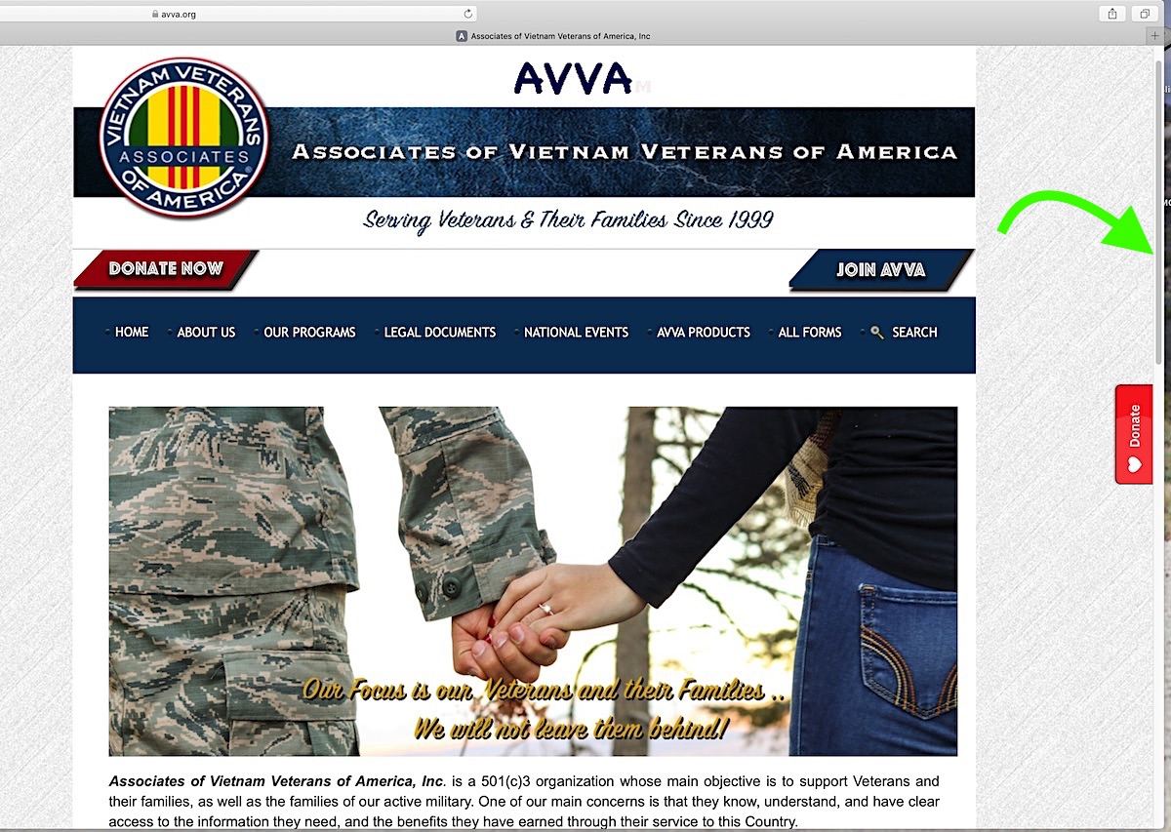
What Can I Find There?
1st thing to know:
Use your scroll bar or whatever tool your browser uses to scroll up and down!

Slide 4
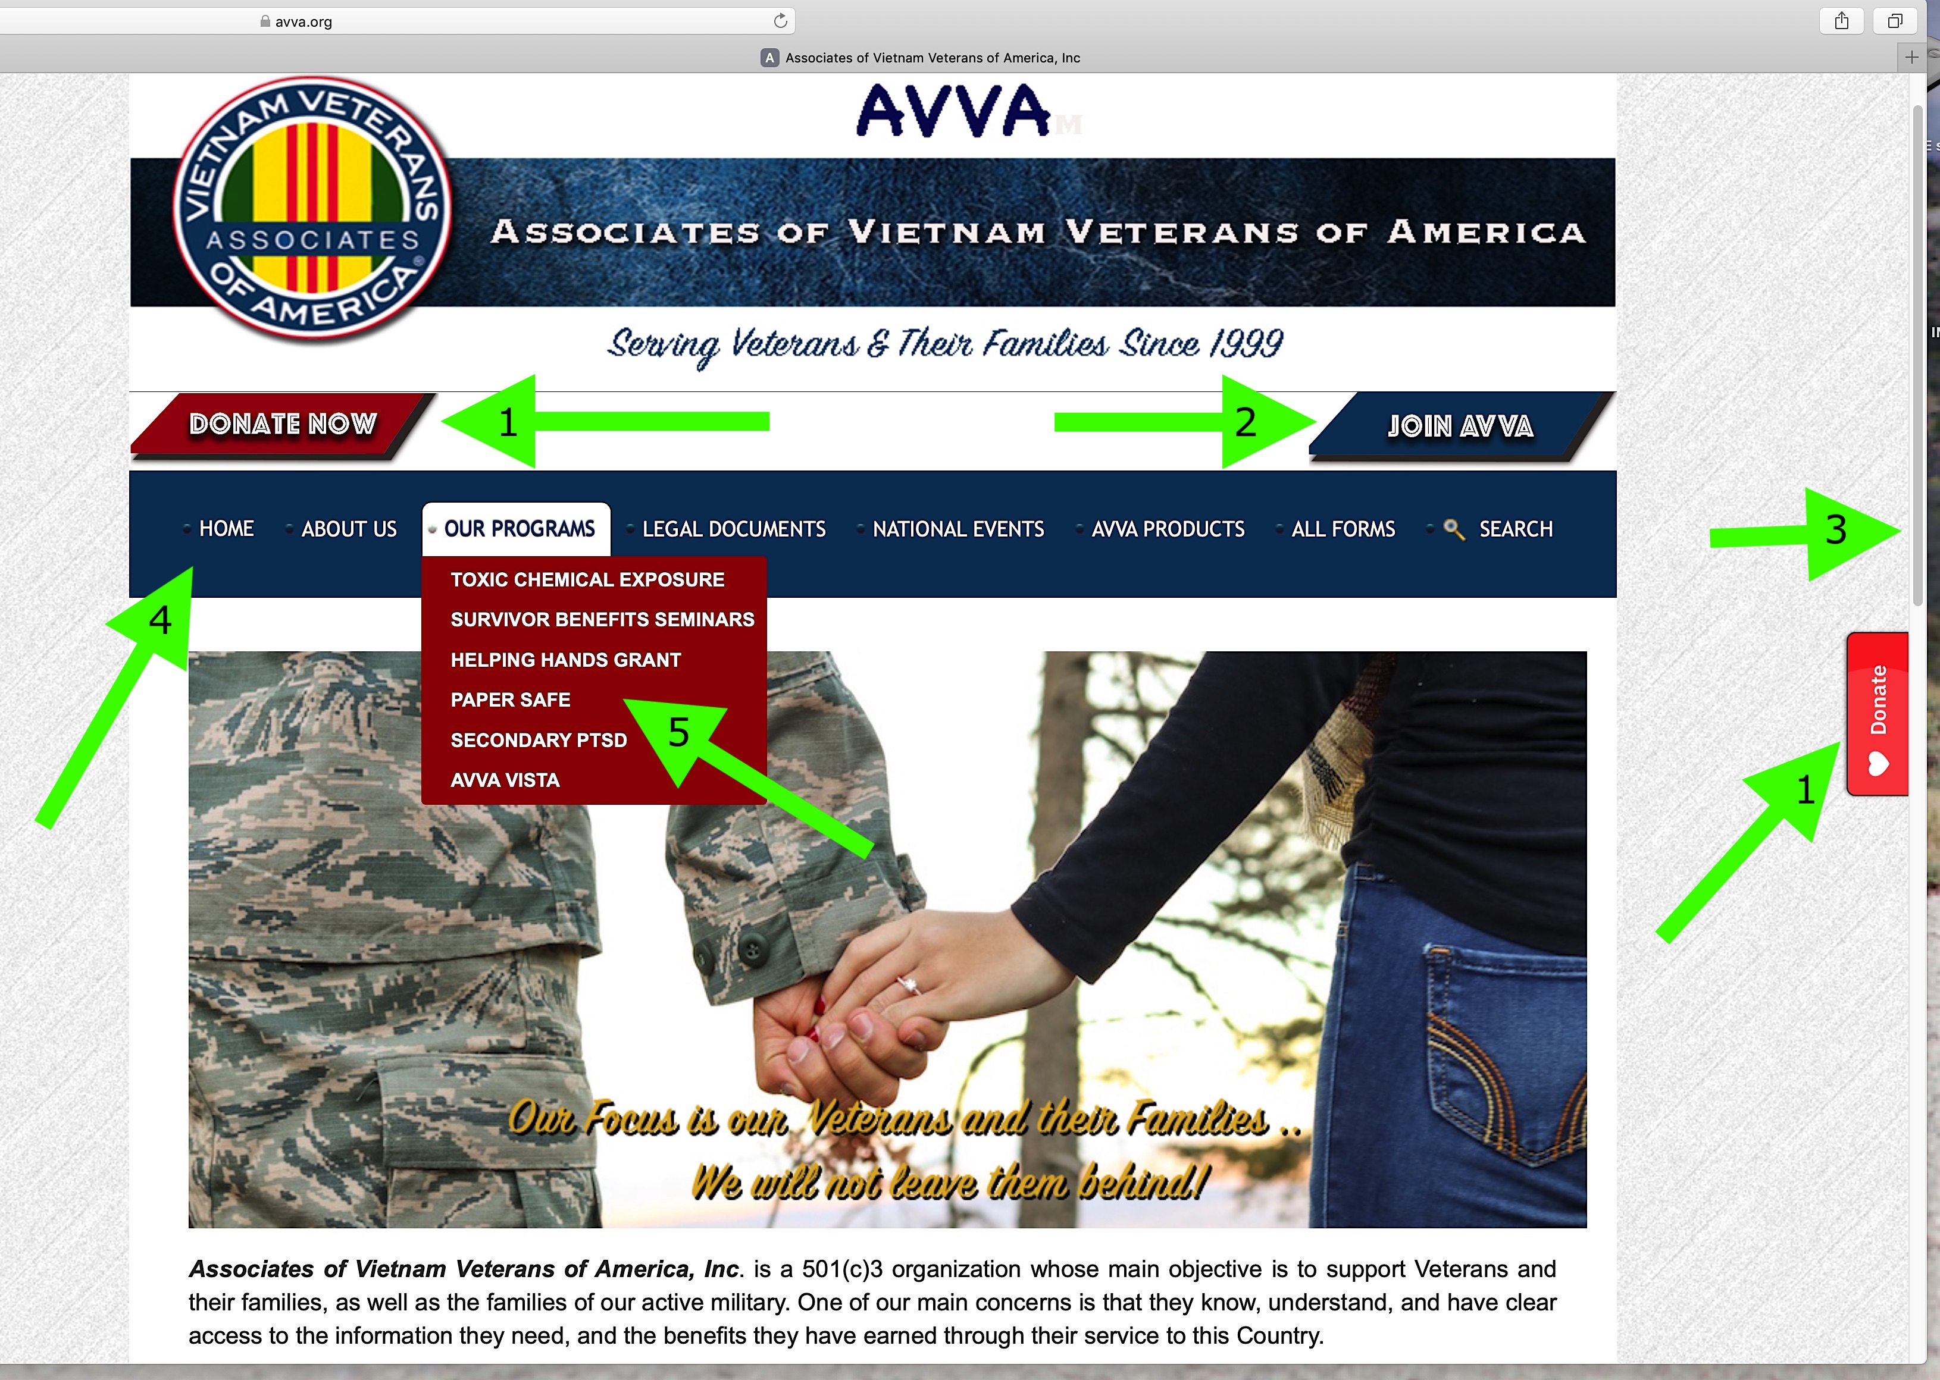
www.avva.org is our “Home” page. From there you can go anywhere in our site. The main tools on this page are:
When you click on any of the links, you will be taken to the most used pages on the website. When you click on one of the words in the Main Menu Bar, you will see the list of the pages that are related to that subject, which you can click on to go to those pages….
1 – Donate Button
2 – Join AVVA page
3 – Scroll Bar
4 – Main Menu Bar
5 – Sub menus

Slide 5
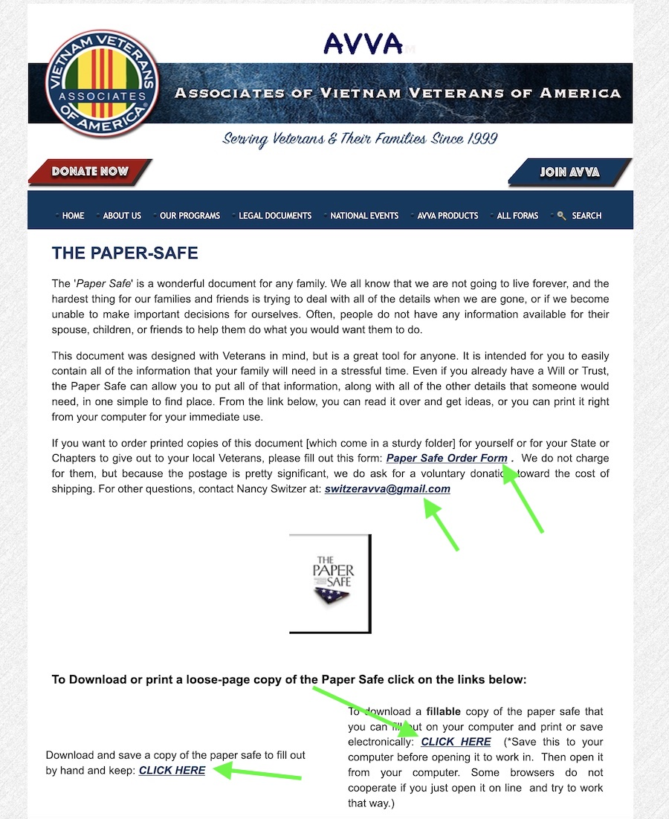
Example:
On the “Paper Safe” page there is good information about what the Paper Safe is, and how it can be used. There are also some “links” to download and save the different versions of the document; go to the order form link to order printed Paper Safe books; use the link to contact the committee chair for questions.

Slide 6
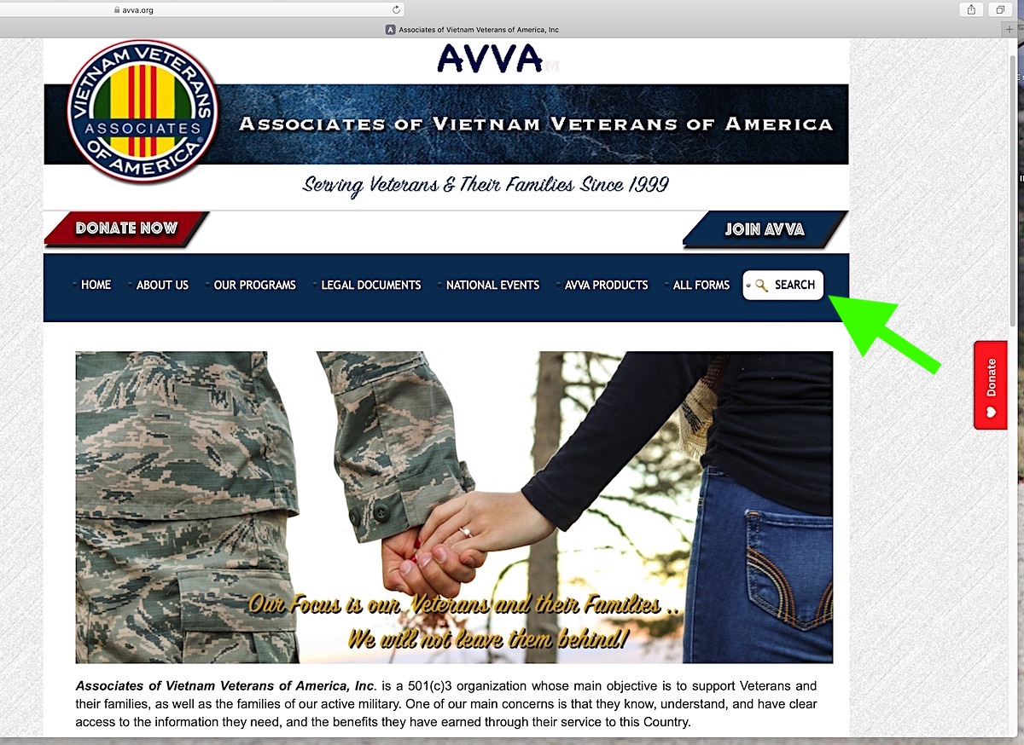
What if I can’t find it?
When you want to to find something fast, click on the “SEARCH” button. For
example, I want to find the form to send election results ………

Slide 7
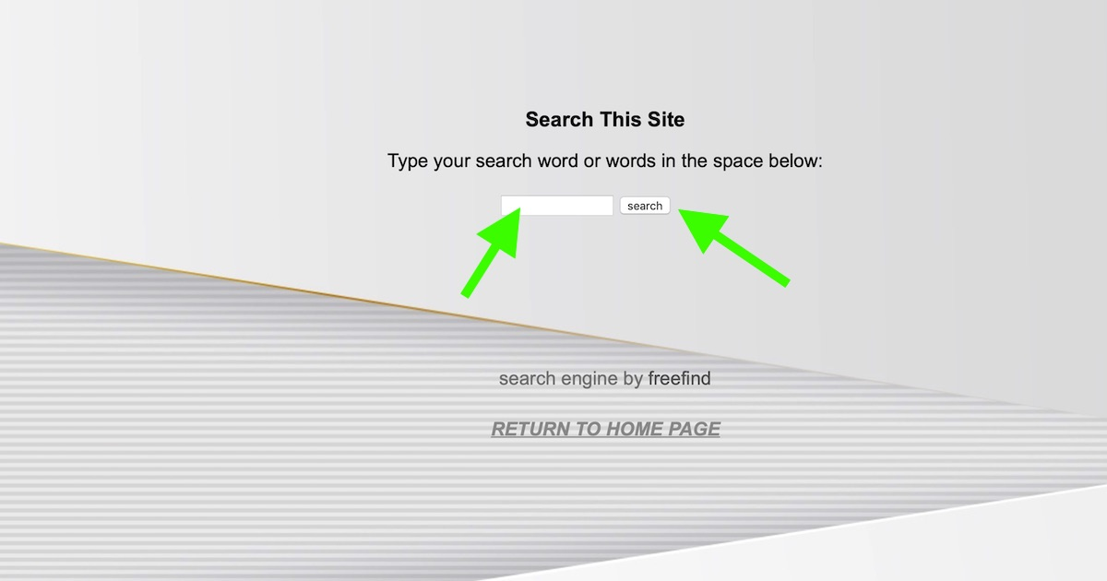
A search page will come up – enter your search word (for example “election results”). Then click on the word “Search” ….

Slide 8
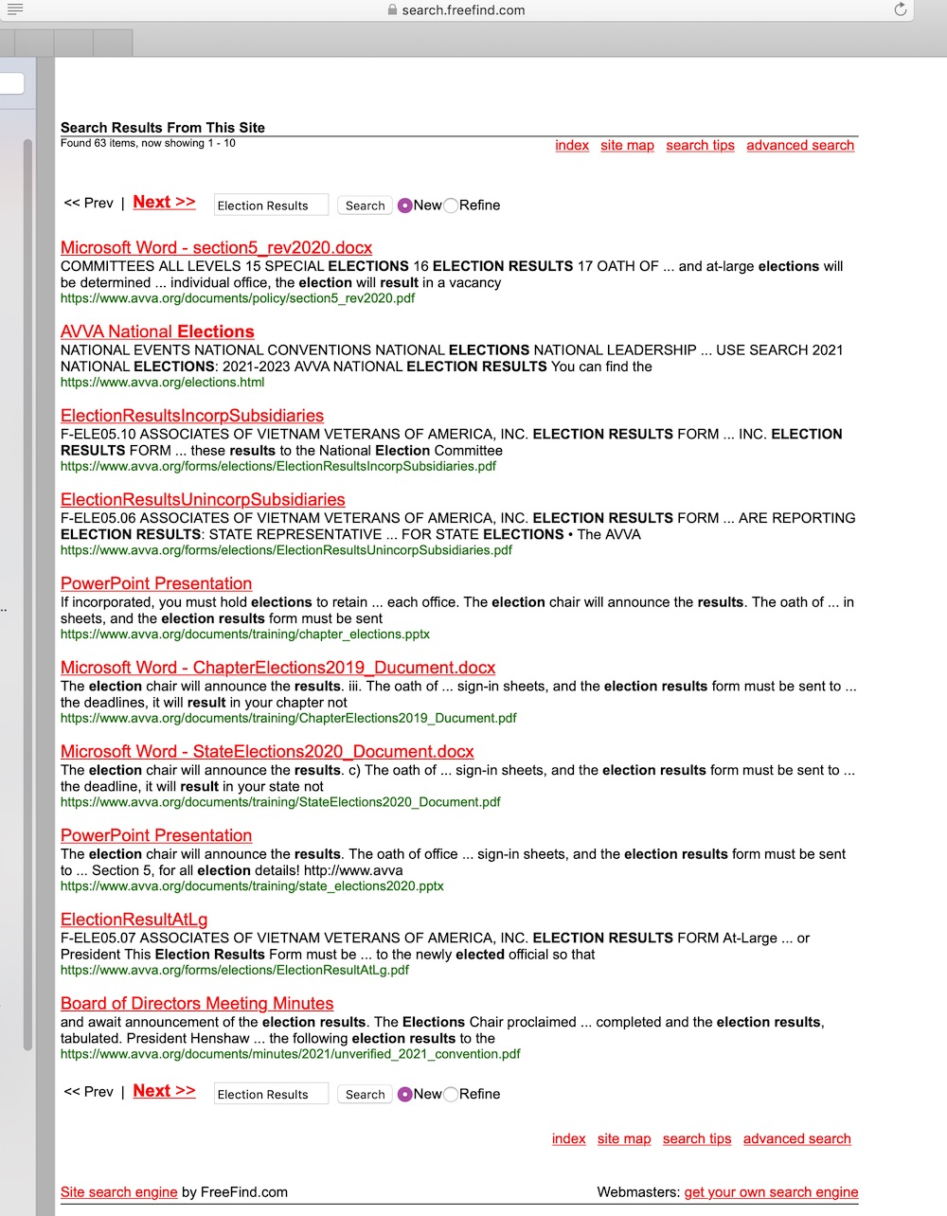
A page like this will come up. You will have responses that relate to your search words. The one you want is not always the first one! For example, here you wanted election results forms, which is the 3rd or 4th response depending on if you are incorporated or not. You can search almost any combo of words. Being as specific as possible helps.

Slide 9
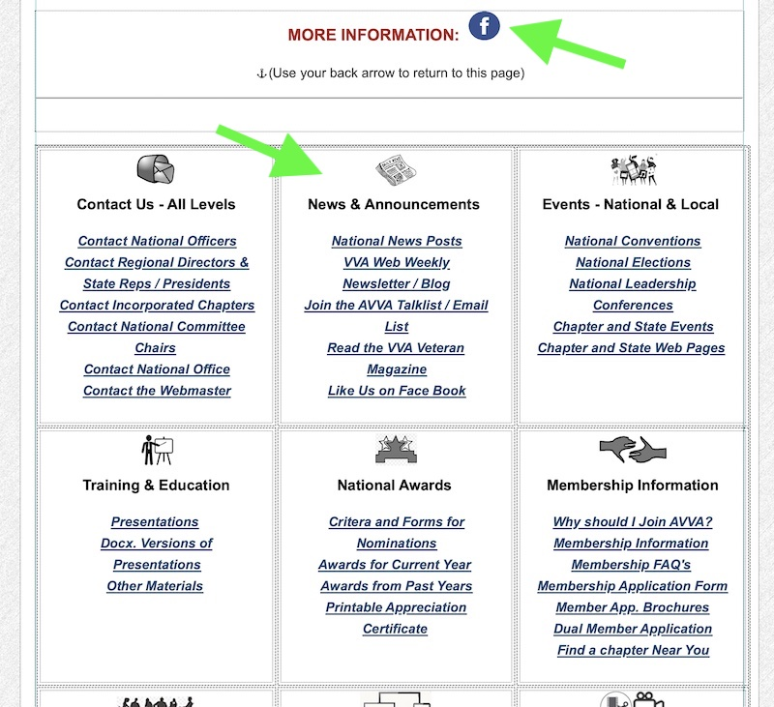
Everything is on the “Home Page”!
Scroll down from the top a bit to find access to all the pages we have! There is so much information!
When you scroll
Down on the home
Page, you will find
a link to our Facebook page….
Also, you will find the pages in the site by category, such as “News & Announcements”

Slide 10
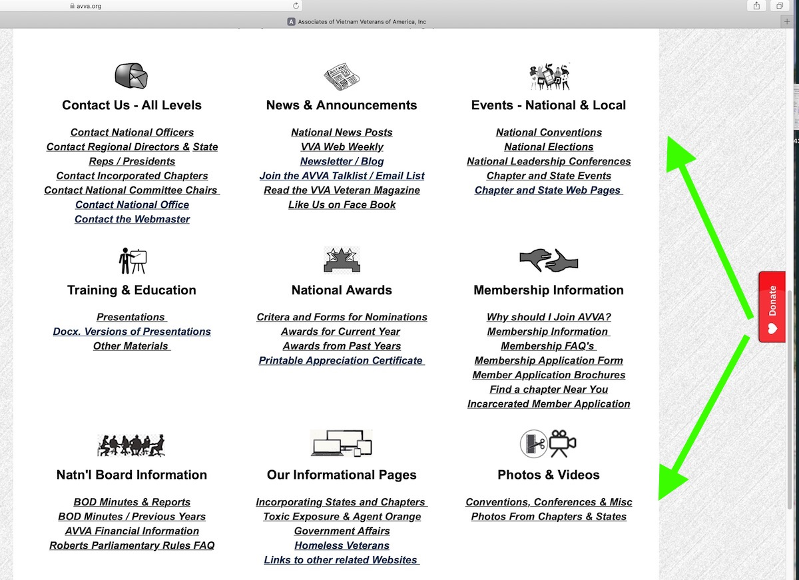
For Example: You want to know how to contact your State Rep or President. Look down at the “Contact Us” list and click on “Contact Regional Directors & State reps/Presidents”. All will be listed there by region. You can also find the incorporated chapter presidents lower down on that page.

Slide 11
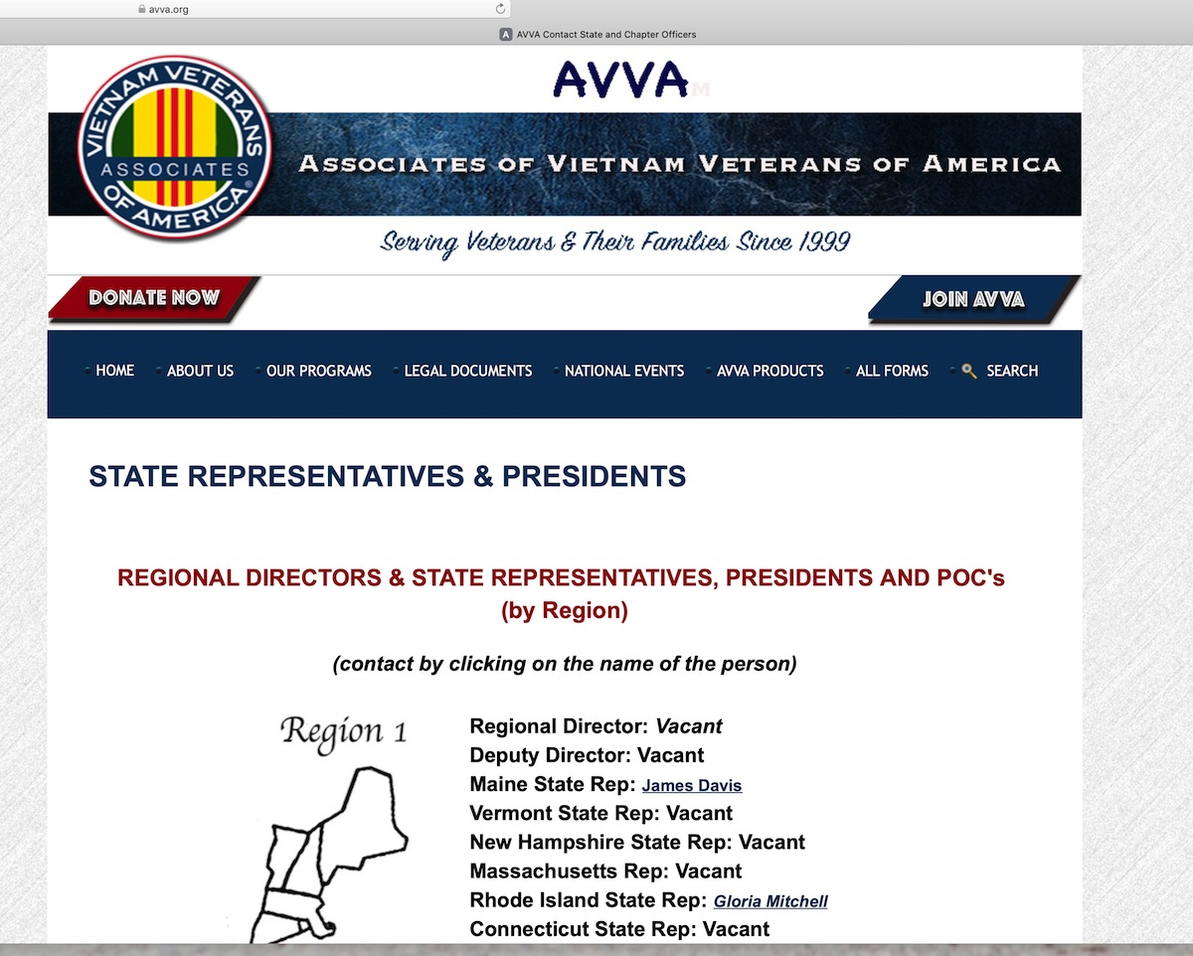
(Contact State Reps/Presidents, chapter presidents…)

Slide 12
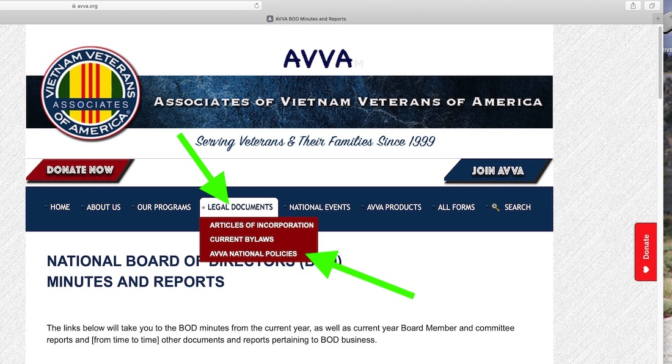
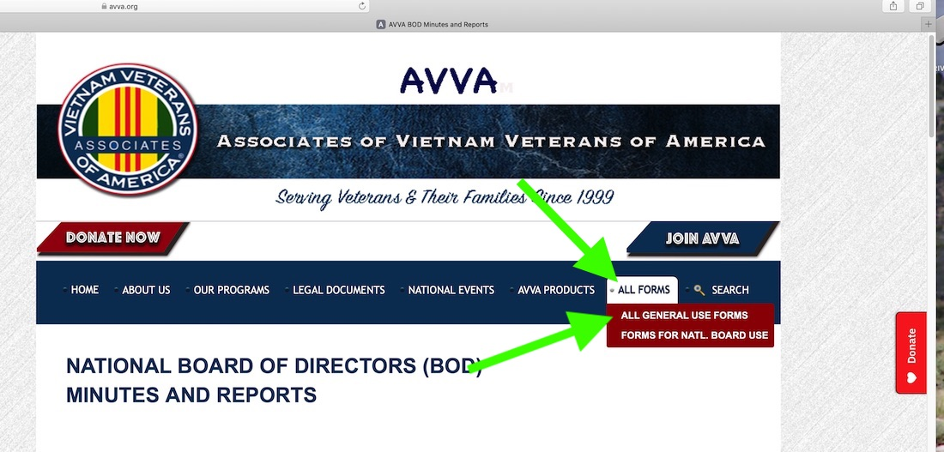
EVERY PAGE HAS A MENU BAR:
The menu bars have sub-menus. Each one will take you back to the home page. If you click on “LEGAL DOCUMENTS” for example, you will see the list of our bylaws and policies etc. Click on one of them to go directly to that document, or list of sections of that document.
Or click on “ALL FORMS” and then on “ALL GENERAL USE FORMS” to find specific ones to read or save.

Slide 13


NOW IS THE TIME TO SAY IT:
You should know that when you open a form to use it on a phone or tablet, they do not perform as intended. These devices use apps rather than programs, and the results are not always the same. Start with finding an “app” that will read and process PDF documents. It might help depending on the abilities of your phone or tablet.

Slide 14

If you want to download and fill out a form, you must know a couple of things first. You will need to be working on a desktop or laptop computer for the forms to function properly. Second, you must know that because of the different ways that different browsers work, your best bet is to save the form to your computer (on your desktop or in an easily found folder in your hard drive) which will make it much easier to use.
Once you have saved the form, open it in Acrobat Reader DC or a similar PDF reading program. (Reader DC is a free PDF reader offered by Acrobat Software. This is a completely safe program if you download it from Acrobat and not a 3rd party website. The link to download it is on our FORMS page in the 1st paragraph. www.avva.org/forms.html)
(NOTE: if you only have a phone or tablet you can always send the form to your printer, print it, fill it out and go from there. Your printer should have a set-up ability for this.)

Slide 15
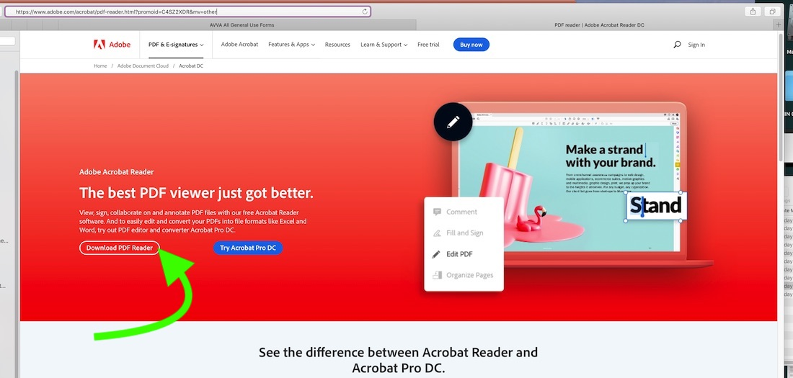
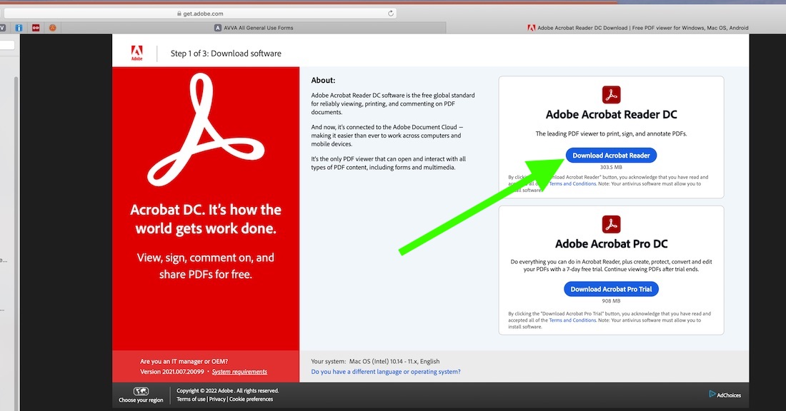
If downloading Reader DC, use “Download PDF Reader”,
NOT “Try Acrobat Pro”.
First …
Then….

Slide 16

If or when asked, let your computer set Acrobat Reader as your default program to open all PDF documents. Your life will be very much easier!

Slide 17
Now I have the form – What do I do with it?
Almost all our PDF and WORD forms are fillable on your computer. Meaning that you should be able to save the form, open it and fill it out, and then save a finished copy (“Save as” with a new file name). So, lets try out a PDF one.
Go to our forms page and choose a form by clicking on its name. When the form opens, save it to your desktop so you can find it easily.
Now, go back and open that form in Acrobat Reader DC. (NOTE: If you are using a WORD version of a form you must open it in Microsoft Office Word). Once you have opened a fillable form you should notice that there are spaces where your curser shows, and that you can tab through with your ”tab” key on your keyboard. Fill out each area as you tab through. (IF YOU WISH, PAUSE THE VIDEO HERE UNTIL DONE WITH SAMPLE)

Slide 18
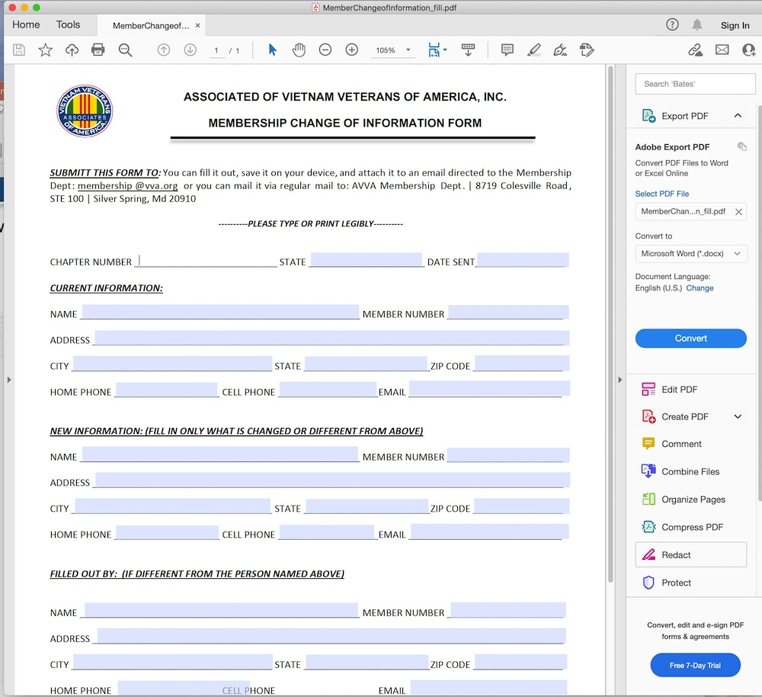
Just tab through to the next place you want to add information
When finished
Do a “Save as” function, not just a SAVE. Do this so that you can give the filled-out document a unique file name, such as “janes member change” instead of the original file name. Your form is now ready to send.

Slide 19

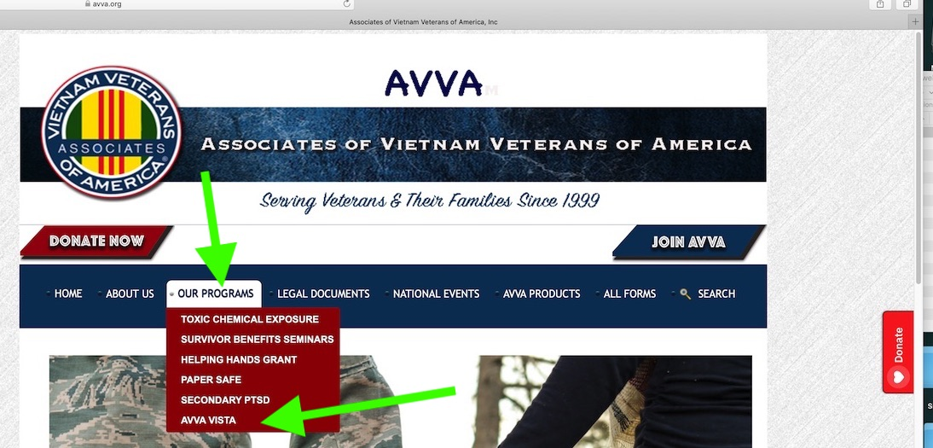
Now, what about the other resources?
I want to know about the Vista Program:
On the main menu, click on “OUR PROGRAMS”, and then “AVVA VISTA”

Slide 20
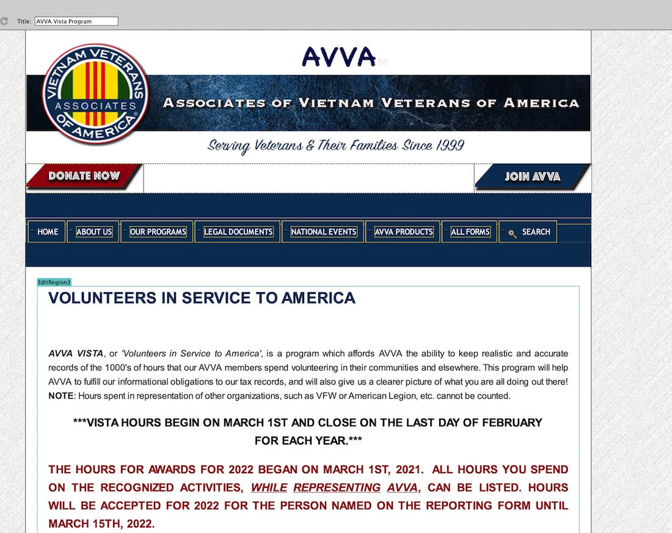
You will get this page:
On this page the
VISTA program info
can be found.
There is a link to the
VISTA form for reporting
your hours.
The VISTA form can be
filled out and sent to
the proper person.

Slide 21


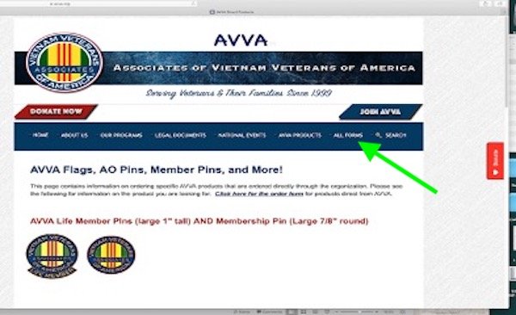
If I want information on
AVVA products?
Using a Main Menu link, click on “AVVA PRODUCTS”, then “AVVA LOGO PRODUCTS DIRECT FROM AVVA”. You will see this page:
Scroll through this page to see our products. There is a link at the bottom of the page to the Order Form.

Slide 22
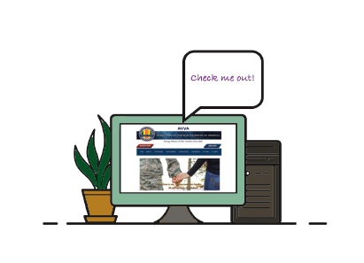
So, now you have some examples of the resources you can find in our website, and how they can work for you.

Slide 23

Play around and find the info you need!
Questions?

